Slide 1
UI Design And Implementation
PRESENTED BY
GROUP 22

Slide 2
Outline
Introduction
Design Principles
UI Design
UI Implementation
Compliance and Accessibility Considerations

Slide 3
1. Introduction
We prioritized creating a user-centered interface that aligns with the various stages of the Disaster Management Lifecycle (DMLC).
We focused both on the functional and non-functional requirements, ensuring the system fulfills its core functionalities while remaining accessible and making sure it adheres to the overall system architecture.

Slide 4
2. Design Principles
Color Theme (#1e7fdb shade of Royal Blue)
Typography (SF Pro Display)
Iconography
Images

Slide 5
3. UI Design
User Personas
Wireframes
Mockup and Visual Design

Slide 6
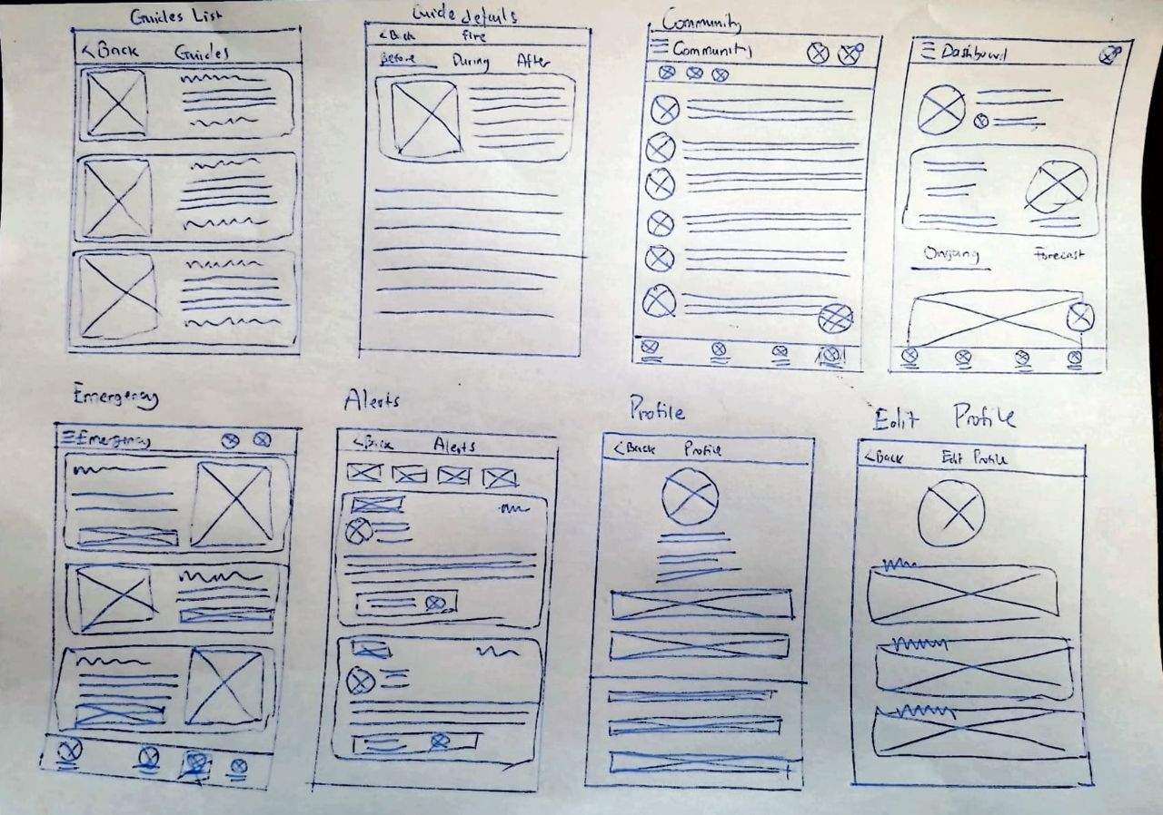
Wireframes

Slide 7
Visual Design and Mockup
User Pages
Emergency Responder Pages

Slide 8
User Pages
Select Language and Login
Home
Emergency Pages
Community
Guides
Announcements
Profile
Alerts

Slide 9
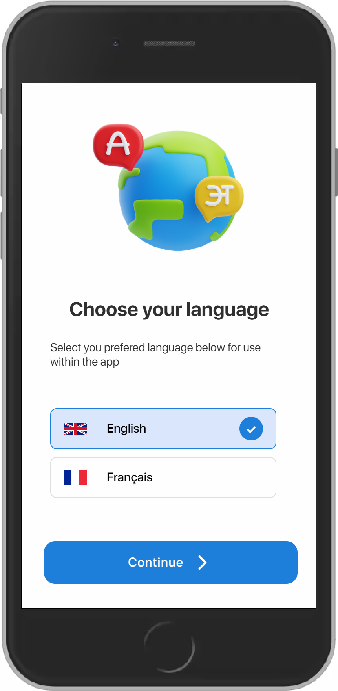
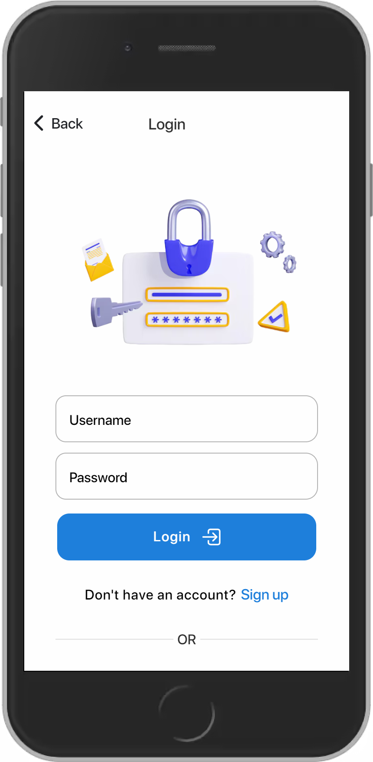
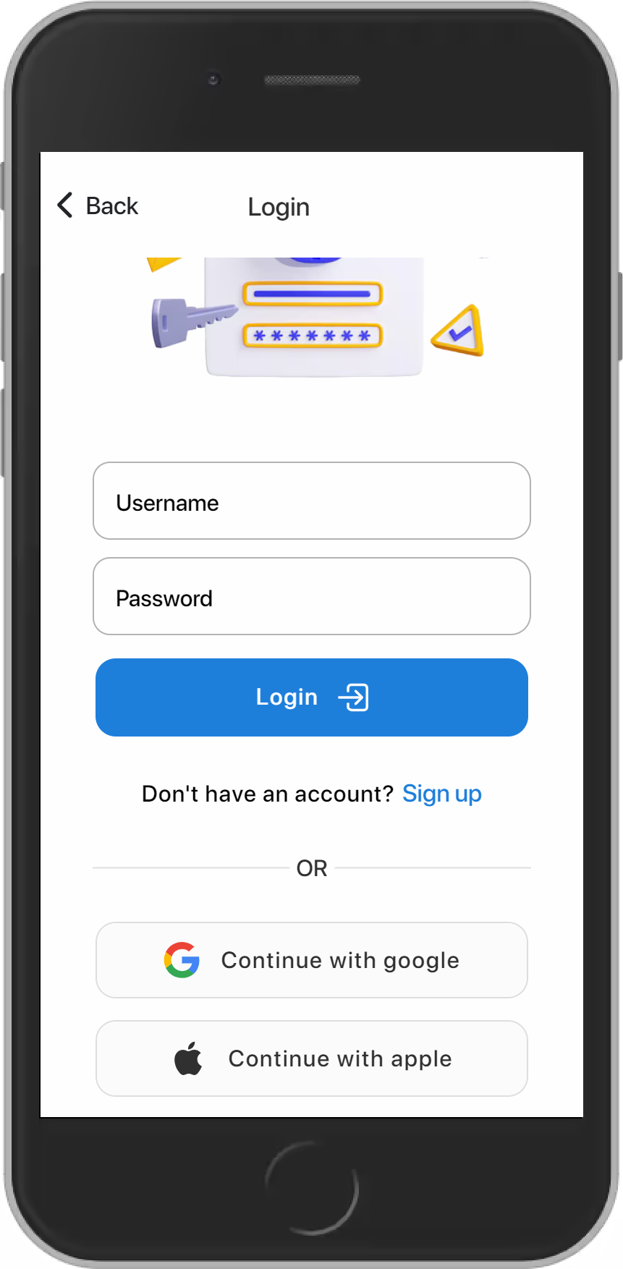
Language Option and Login

Slide 10
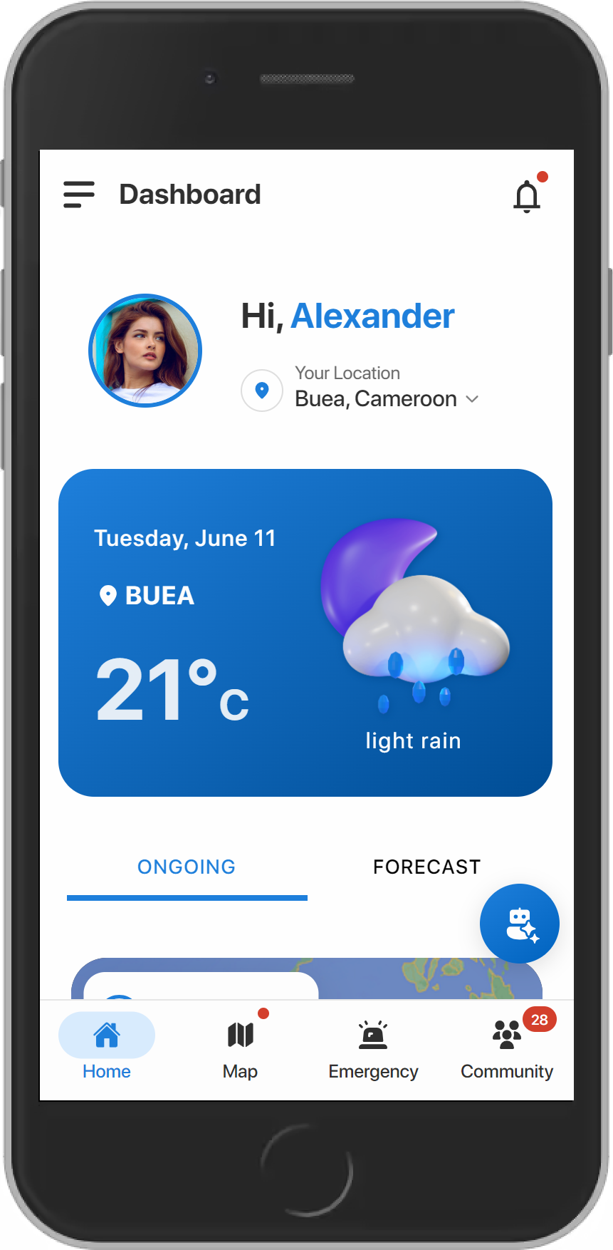
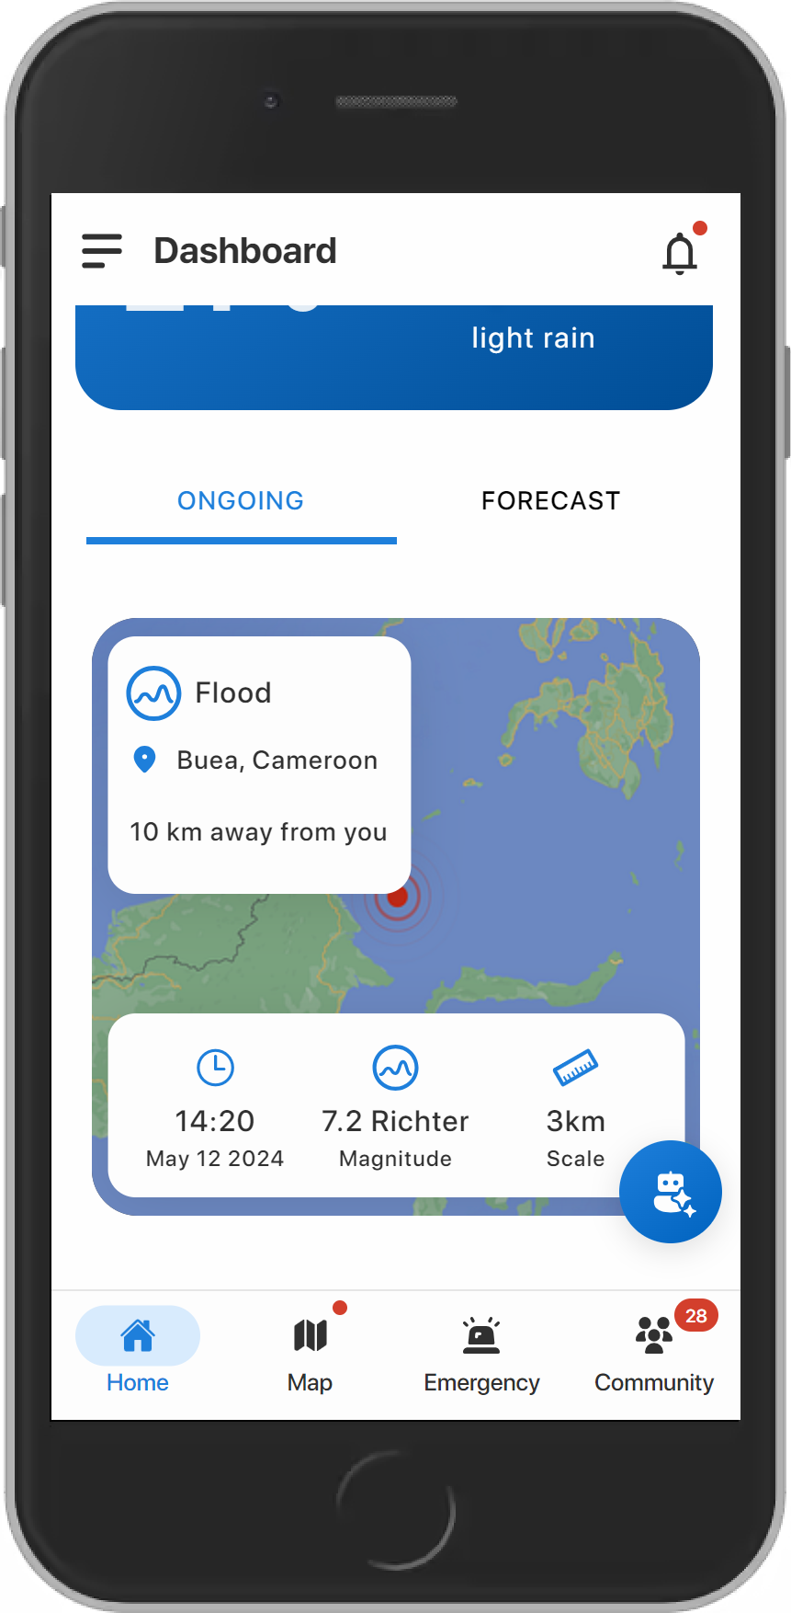
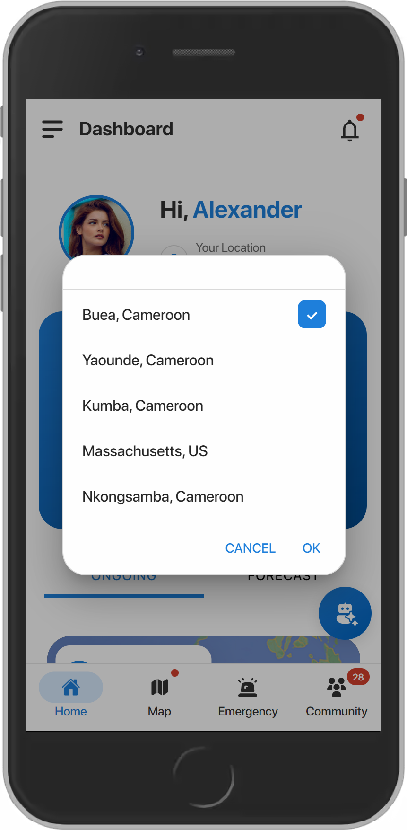
Home Page

Slide 11
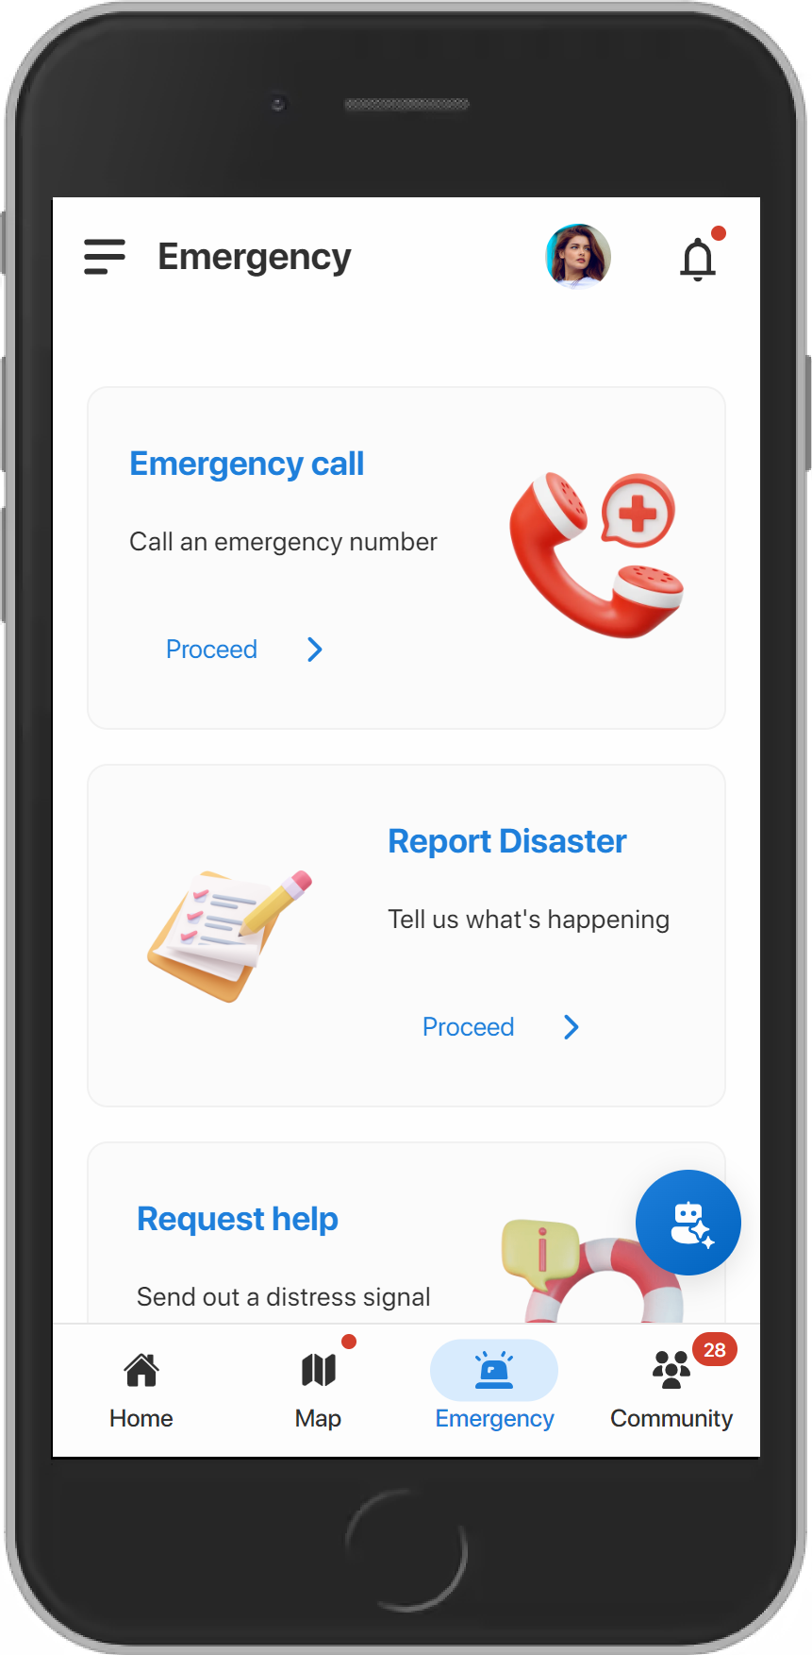
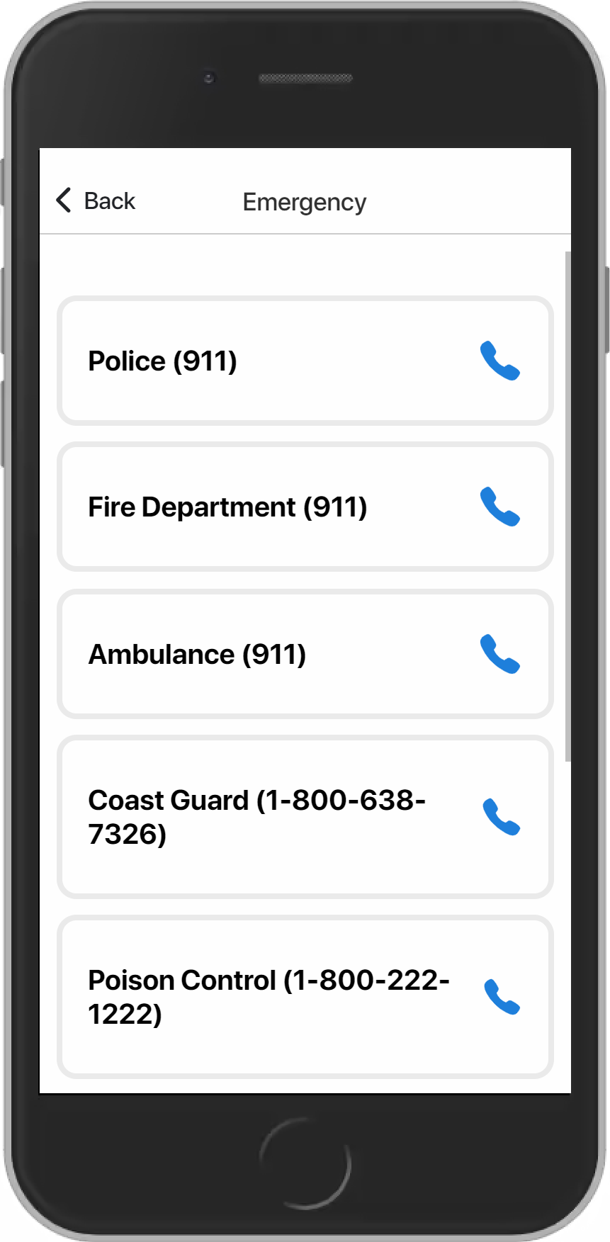
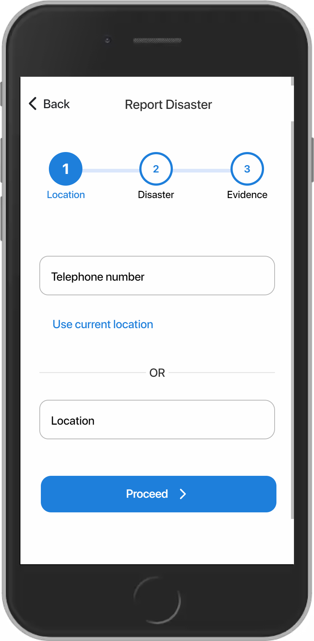
Emergency Pages

Slide 12
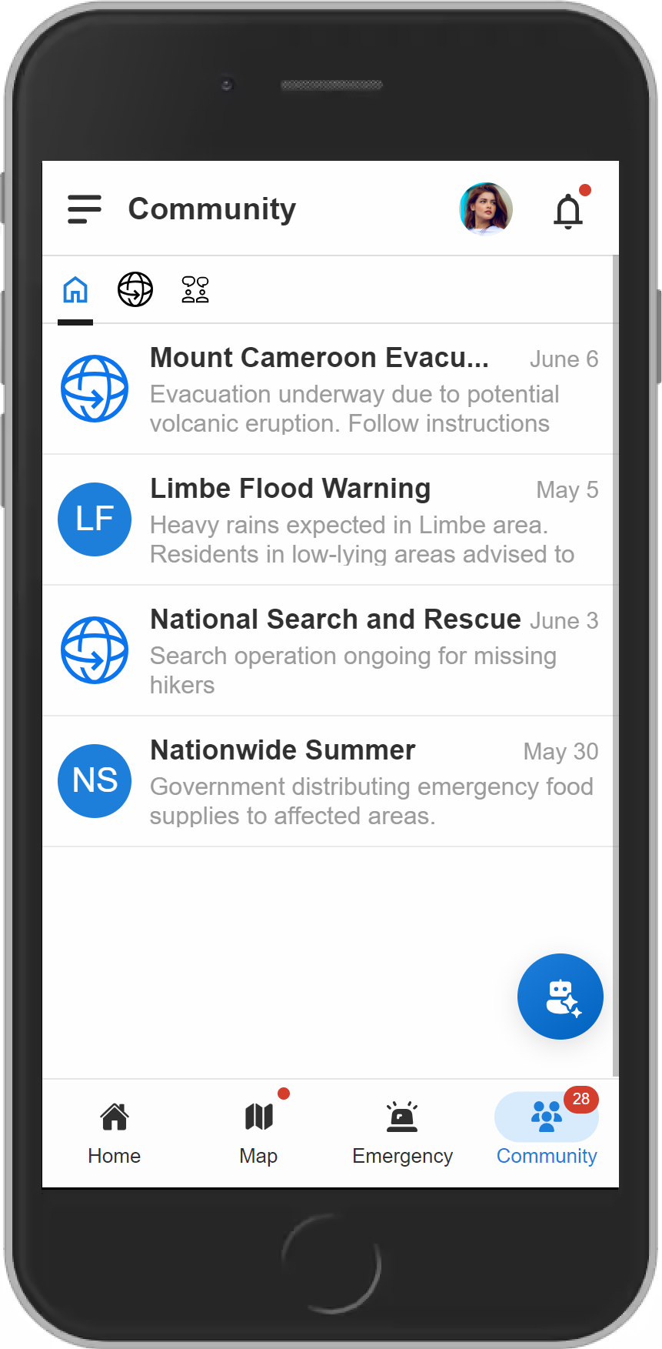
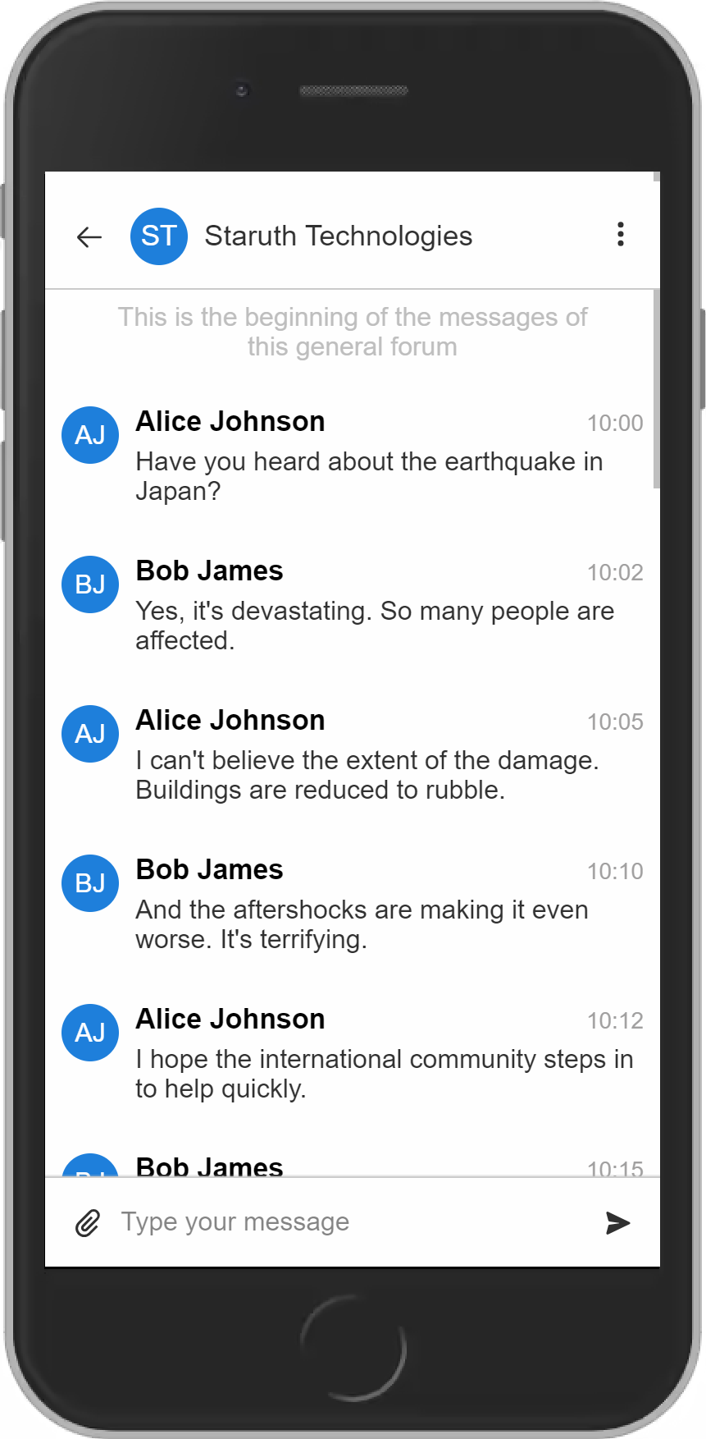
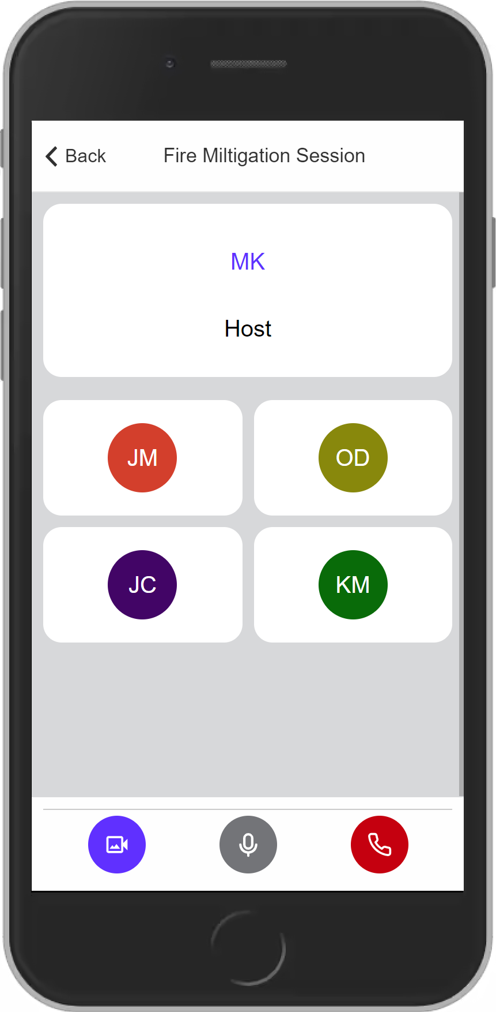
Community Pages

Slide 13
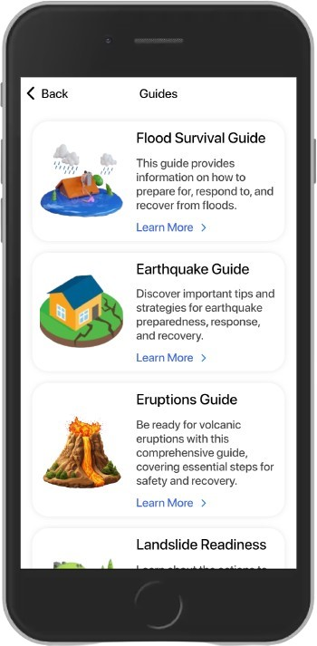
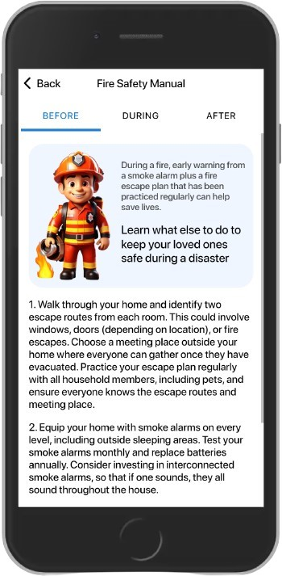
Guides

Slide 14
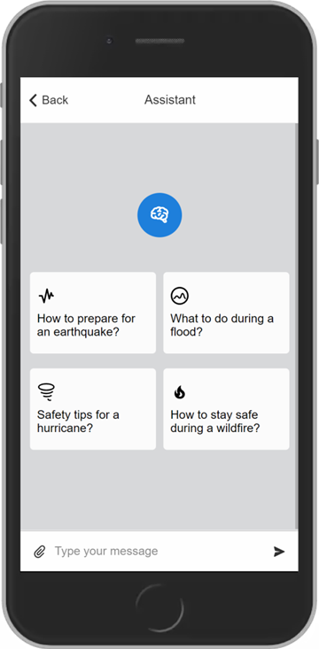
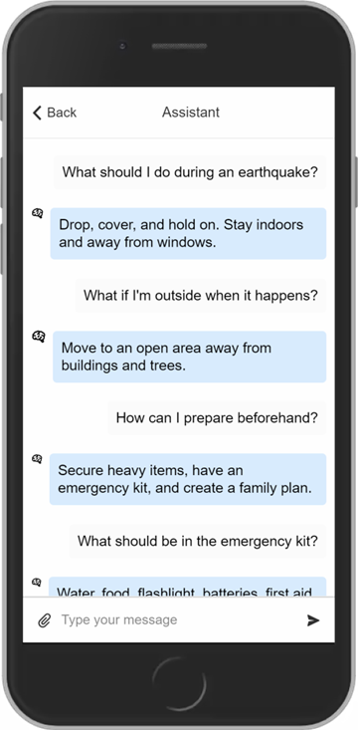
Assistant

Slide 15
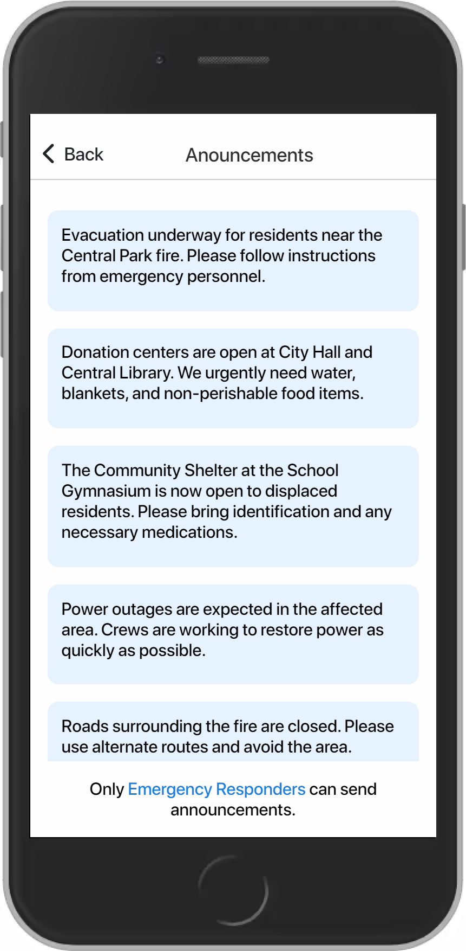
Announcements

Slide 16
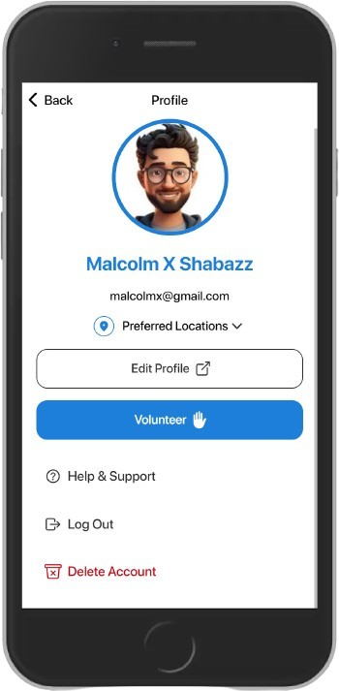
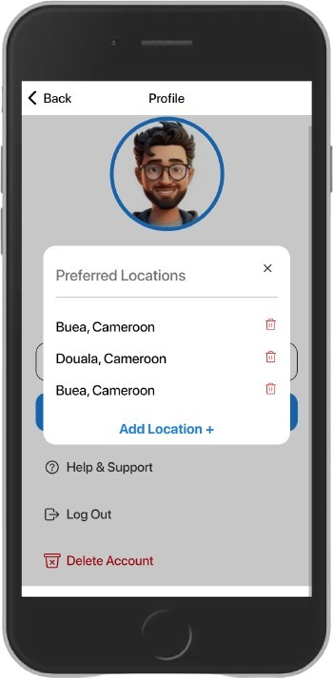
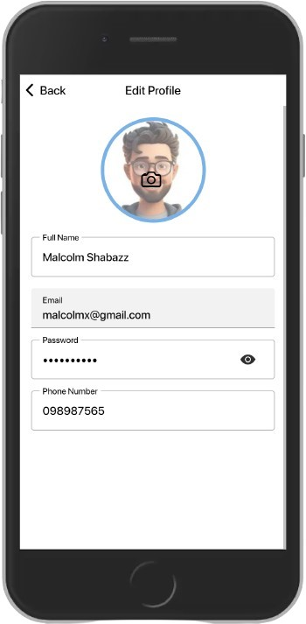
Profile Pages

Slide 17
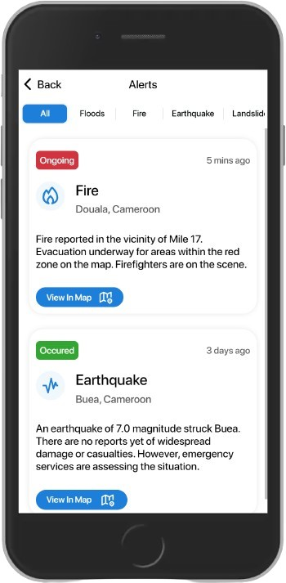
Alerts

Slide 18
Responder Pages
Alerts
Announcement

Slide 19
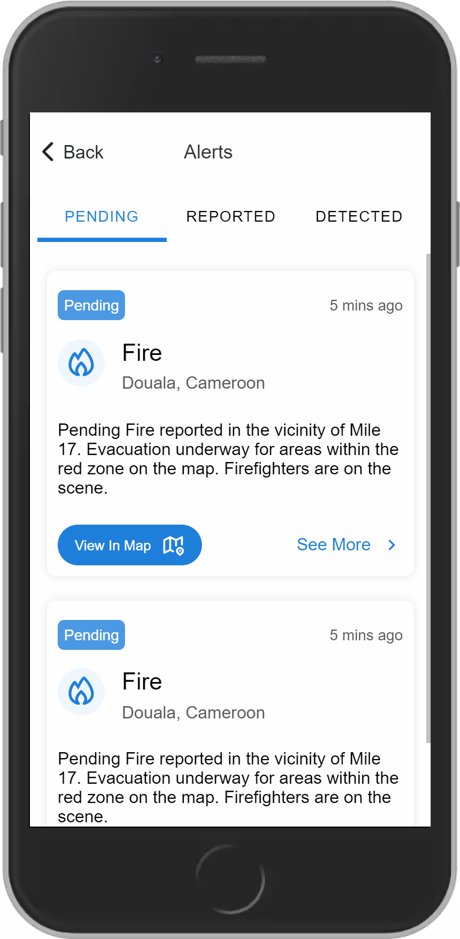
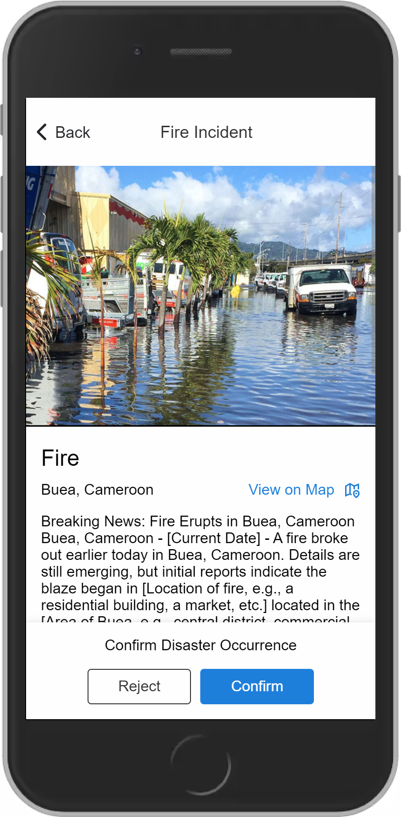
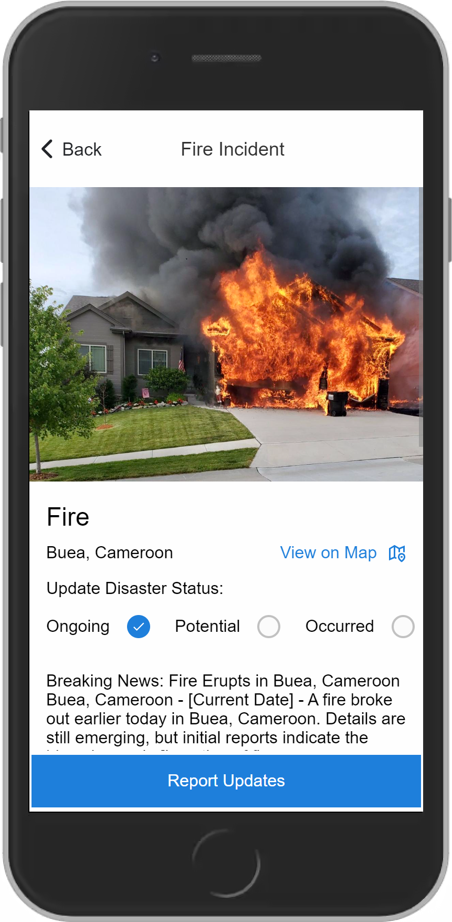
Alerts

Slide 20
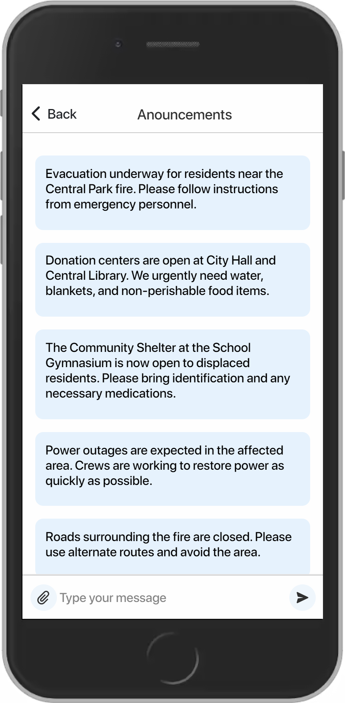
Announcements

Slide 21
4. UI Implementation
Technologies Used
Ionic with React Ts
Version control with GitHub

Slide 22
5. Accessibility and Compliance 1/2
Ionic takes compliance guidelines into consideration when developing its framework and components. Here are some of the key compliance areas that Ionic addresses:
Security Best Practices
Compliance Certifications
GDPR (General Data Protection Regulation)
FISMA (Federal Information Security Management Act)
ADA (Americans with Disabilities Act)

Slide 23
5. Accessibility and Compliance 2/2
Ionic has made a strong commitment to accessibility and strives to ensure its framework and components adhere to various accessibility guidelines and standards, such as:
Color Contrast
Localization and Translation
Section 508
Keyboard Accessibility
ADA (Americans with Disabilities Act)
WCAG (Web Content Accessibility Guidelines)

Slide 24
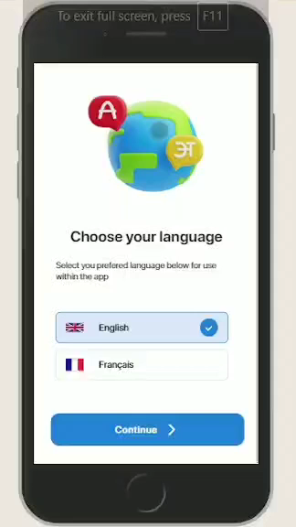

Slide 25
THE END!!!

